Slide 2
European University of Tirana
1. What is measured /can be measured at your university to assess research performance?

Slide 3
Scientific impact:
Number of scientific publications (national and international level/ single author or co-authors/ students' involvement in research)
articles
policy papers
monographs
Number of conference papers (national and international level)
how many and where?
Proceedings and index
Rating the citation importance
Scopus
Journal Citation Reports
SENSE Ranking of Academic Publishers

Slide 4
Research impact to society:
Extent of citizen involvements in research (focus groups, interviews, questionnaires)
Number of case studies resulting from the research activities
Policy papers on social phenomena
Research impact to policy making:
Number of co-creation activities with public authorities at:
local level
national level
regional level

Slide 5
Research impact to business:
Number of company spin-offs
Number of research-based courses for business
Number of academia-business networks, partnerships and clusters
Number of contracts/ agreements/ Memorandums of Understanding resulting from academia-business interaction.
Research impact to education:
Number of research-oriented courses for students and young researchers
Number of research staff with doctoral degree (PhD candidates)
Number of external/visiting professors
Availability of R&I advisory and counselling services
Students' involvement in research
Students’ research out-puts (DSSH Junior Researchers)

Slide 6
2. How to measure and how to set up a process for measuring the KPIs: responsibilities, frequency, tools, phases and an Action plan

Slide 7
Scientific Research System at European University of Tirana:
Vision, mission and objectives
Statute
Regulation
EUT Research Strategy 2021 – 2025
Structure (implementing and support structures)
Academic Senate
Vice Rector for Teaching Process and Scientific Research
Research Units (faculty level)
Research groups (academic/research staff)
Board for the Financing of Academic Research
Office for Project Development and Partnerships
Library, UET Press, laboratories, hubs, etc.

Slide 8
Scientific Research System at European University of Tirana:
Implementation of Strategic Objectives
Strategic Planning at EUT is based upon a cyclical process, which begins with the setup of Strategic Research Objectives and proceeds with the selection - based on quality, scientific rigor and academic pertinence - of the research projects the university funds
The integrated plans of Scientific Research, with well-delineated temporal limits, are designed with clear attribution of responsibilities and obligations for each of the offices involved in the research process from the academic units all the way to the administrative support offices. These Plans must delineate the financial cost also.

Slide 9
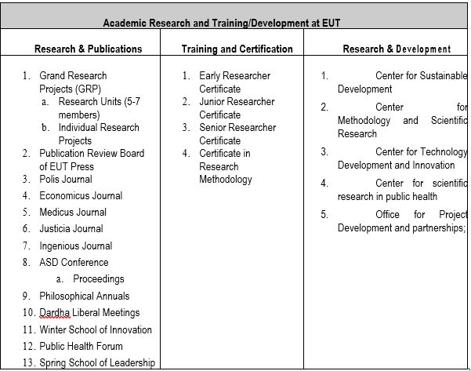

Slide 10
 | INDICATORS FOR THE MEASUREMENT OF ACADEMIC RESEARCH PERFORMANCE
No. | Obligation/Output | Points
I | MAIN OBLIGATIONS
1 | Project initiated/commissioned by EEI | 25
2 | Scientific article published in a journal ranked in Scopus | 25
3 | Scientific article published in a journal ranked in Journal citation reports | 50
4 | Chapter in edited book (published by reputable international publishing houses | 25
5 | Book (published by reputable international publishing houses) | 75
II | Presentations and Other Publications
1 | Original scientific article published in EUT journals | 15
2 | Published book reviews (EUT Press or otherwise) | 5
3 | Peer reviews to articles under review for EUT journals | 2.5
4 | Presentation in EUT national conference | 5
5 | Presentation in EUT international conference | 10
6 | Scientific book published by Albanian publishing house | 50
7 | Academic textbook in Albanian | 50
8 | Translation of scientific book | 20
9 | Editing of scientific book | 10
10 | Original scientific article published in indexed journals | 10
11 | Publication in national conference proceedings | 5
12 | Publication in international conference proceedings | 15
13 | Peer reviewer for international scientific journals in OECD countries | 5
III | PROJECTS COMMISSIONED BY EUT AND PARTNERS
 | Project commissioned by the Office for project Development and partnerships EUT
1 | Write up of concept notes and assistance for project applications | 5
2 | Engagement as project coordinator (1 working day in the project = 2 points) | 2/day
3 | Engagement as project member/expert (1 working day in the project = 1 point) | 1/day
4 | Consulting for EUT Consulting & other EUT partners (1 working day = 1 point) | 1/day
IV | EXPERTISE FOR THIRD PARTIES
a | Consulting and expertise for Third Parties
1 | Consulting and expertise for national organisations | 15
2 | Consulting and expertise for international organisations | 20
3 | Team leader for regional research project | 20
4 | Team Leader for international research project (OECD) | 25
5 | Organiser/lead of session/panel in national/regional conference | 5
6 | Organiser/lead of session/panel in European/international conference | 10
7 | Member in academic/scientific/professional national board | 7
8 | Member in academic/scientific/professional international board | 10
15 | Guest lecturer in Western university (OECD) | 10
b | Mediatisation (only professional appearances not political opinion)
1 | Media articles | 2.5
2 | Appearances in visual media (professional expertise) | 2.5
3 | Other materials/activities deemed reasonable by the evaluating committee
 | The minimum number of points required by members of the academic staff per category
 | Doctor/PhD | 50 points
 | Prof. Asoc. Dr | 75 points
 | Prof. Dr | 100 points

Slide 11
Thank you for your attention!
Contact:
Prof. Dr. Drita Kruja
Vice Rector
e-mail: drita.kruja@uet.edu.al
Dr. Fatri Morina
Lecturer
e-mail: fatri.morina@uet.edu.al
Website: https://uet.edu.al/en

