Slide 2
Developing Research and InnoVation CapacitiEs in Albania and Kosovo/ DRIVE
Ref. no. 610307-EPP-1-2019-AL-EPPKA2-CBHE-JP
Sustainability and networking workshop (WP5/WP9)
The DRIVE Virtual Platform
13-14 October 2022 (Milano, Italy)

Slide 3
Motivation and goals
Contribute to the development of the research and innovation capacities of HEIs in Albania and Kosovo by facilitating networking between partners
Promote research excellence and innovation by developing a network that eases the interdisciplinary and cooperation among local and international actors
Goals
Facilitate the sustainable development of research and innovation capabilities of HEIs in Albania and Kosovo
Enable the easy exchange of research ideas and resources between project partners
Facilitate inter-disciplinary research collaboration at regional and international level

Slide 4
What is the Virtual Platform
A web-based online collaboration tool
driveplatform.eu
Accessible via the DRIVE project website
Available to Consortium Partners only (for the moment)
Access restricted to registered users only, except general information sections
Possibility for outside partners to register (Register link)

Slide 5
Features of the Virtual Platform
Discover and search - Invitations and Calls for Collaboration section
Discover new research initiatives and funding opportunities
Registered users will be able to publish calls and invitations for collaboration.
Users can be grouped into research teams and the team leader can post calls and invitations on behalf of the research team
Interested researchers can then get in touch to share details

Slide 6
Features of the Virtual Platform
Discover and search - Invitations and Calls for Collaboration section

Slide 7
Features of the Virtual Platform
Structured project management
Registered users/research team can publish their research projects,
They can list participants to the project
Publish deliverables, reports, publications that result from the project.
Announce activities planned within the project
Publish reports of completed activities.
The platform will also feature a Calendar of activities, where other users can discover activities announced by other users which may be of interest
Items posted in the platform will have different visibility options

Slide 8
Features of the Virtual Platform
Structured project management

Slide 9
Features of the Virtual Platform
Dissemination and reach
A repository for research outputs.
Registered users will be able to store
published manuscripts and drafts
media, code, technical reports, etc.
All publically visible items will be available also to unregistered visitors of the platform, thereby contributing to the dissemination of the research results.

Slide 10
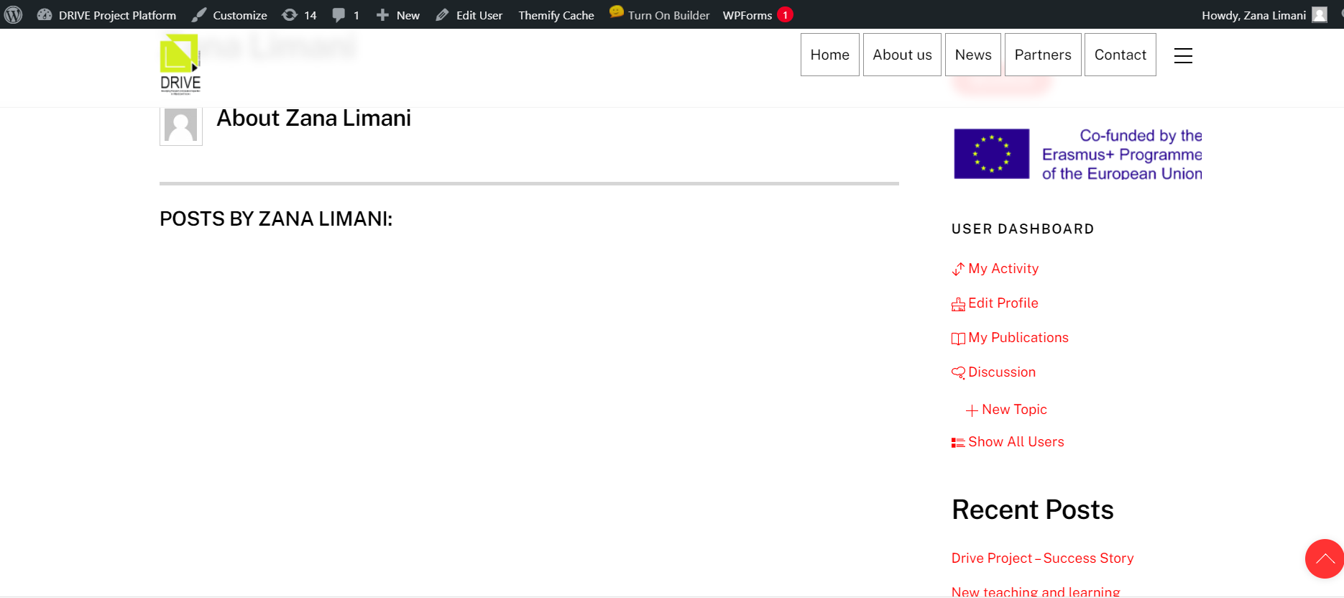
User Dashboard

Slide 11
Using the platform
Content management using WordPress Dashboard
Click here for Log In

Slide 12
Using the platform
Content management using WordPress Dashboard
Guidance provided by contractor on how to use WordPress
Click here to access WordPress dashboard

Slide 13
Thank you for your attention!

